Slide 1
Predicting the outcome of engine bench test
Rohit Ediga

Slide 2
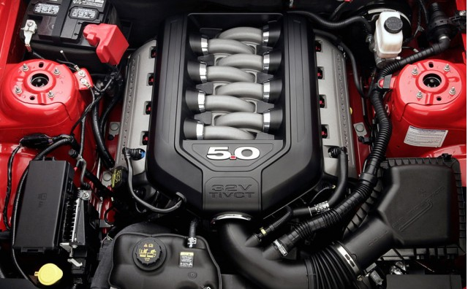
Agenda
Business case & problem statement
Dimensions of the data
Pre-Processing
Model building and Evaluation
Summary

Slide 3
Business Case
Problem Statement
A leading car manufacturer is designing an automobile engine. It is required by law and regulations, that a given engine configuration is goes through rigorous engine bench test before it is passed for production
Determine through analytics model if their new design will pass or not
Each bench test is an expensive, noisy and time consuming process.
This will help them narrow down only few configurations for further testing on physical bench test.

Slide 4
Ford's Global Product Manager Said, “Cars are far more complicated to engineer than airplanes and Space Shuttles. [Airplanes] don't have to be subjected to the same conditions customers subject cars to. I don't think there is anything more complex than the amount of engineering that goes into an automobile.”
Source: https://www.autoblog.com/2010/07/27/why-does-it-cost-so-much-for-automakers-to-develop-new-models/

Slide 5
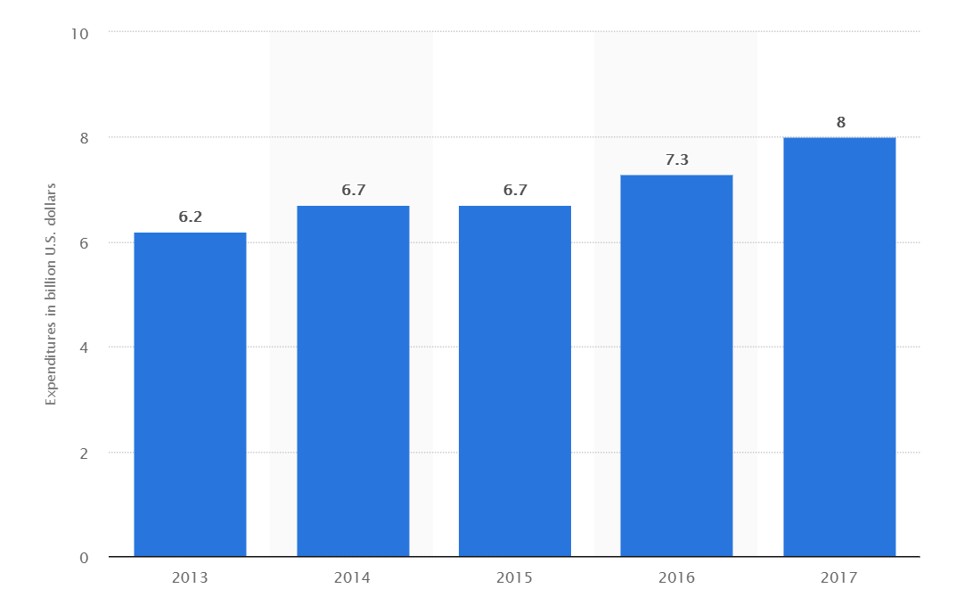


Slide 6
Dimensions of the data
Attribute | Details
Rows | 3156
Columns | 21
Missing Values | 3002
No. of Categorical columns | 21
No. of numeric columns | 0
Type of problem | Binary Classification

Slide 7
Proportion of classes in target variable

Slide 8
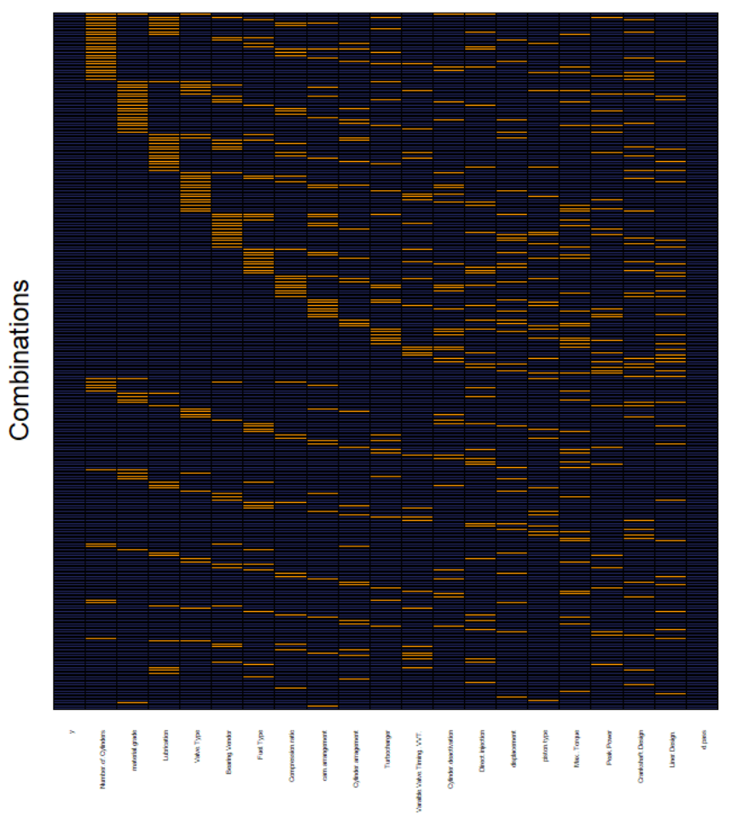
Pre-processing:
Remove ID columns
Impute missing values using mode of nearest neighbours using K-NN
Check for difference in levels in train and test
Remove columns which have near constant value levels

Slide 9
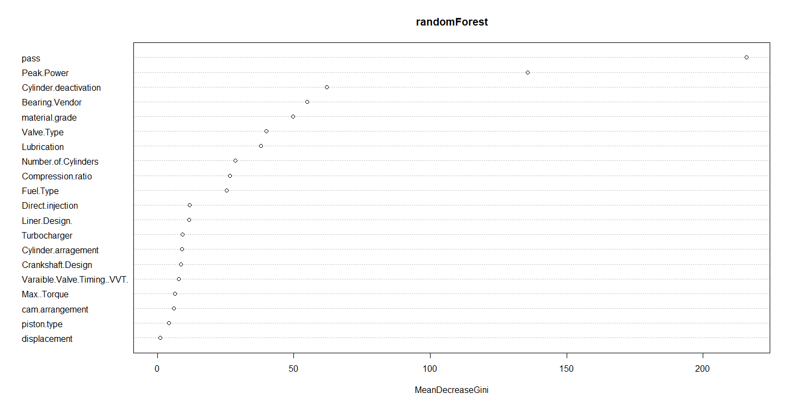
Model Building – Best model – Random Forest
Random forest model was built initially using all attributes and random search was used to get the optimal number of mtry = 3
Only few attributes are important
Results with Feature selection according to variable importance
was not satisfactory

Slide 10
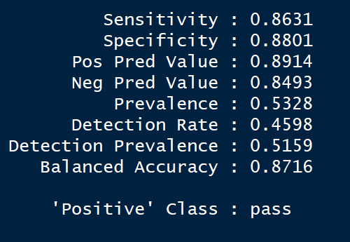
Model Building – Best model – Random Forest
To get the maximum accuracy with as less predictor variables possible “manual search” was used.
“Peak.power”, “pass”,” Fuel.Type” turned out to be the most important variables
Model with these 3 variables fetched a validation accuracy of 87%

Slide 11
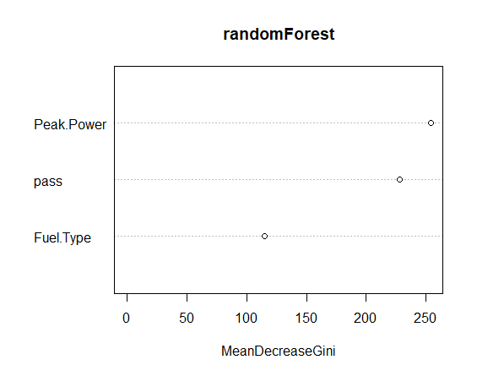
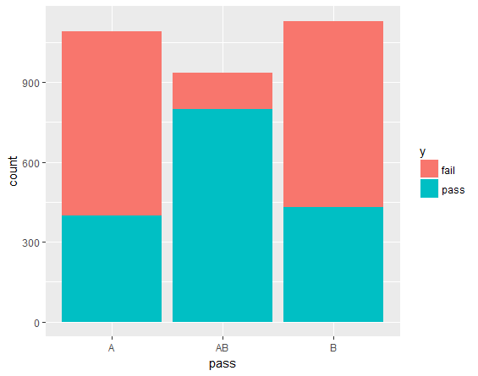
Feature importance
Pass effecting target

Slide 12
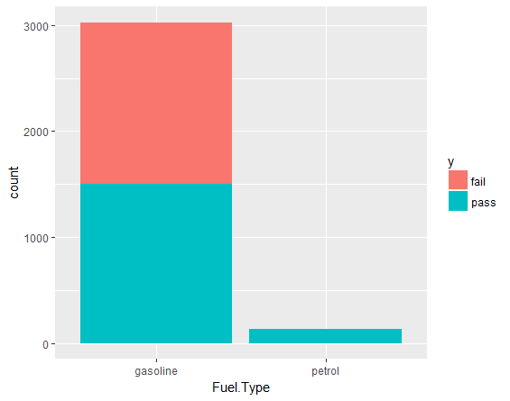
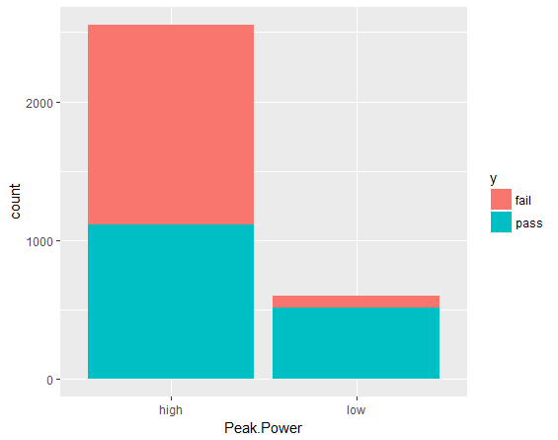
Fuel.Type effecting target
Peak.Power effecting target

Slide 13
Other Models
Model | Validation accuracy
Logistic with 4 variables Selected through stepAIC | 87 %
SVM with 5 variables selected through manual selection with “radial” kernel and gamma = 10 | 87 %
Xgboost with all variables and nrounds = 4 | 86.95 %

Slide 14
Thank You!

